Slide 1

Analysis for network capacity and resources utilization
Exploring dataset of historical data ranging from 6 to 18 months on an average of 1 million appointments per day.
Looked into:
5 service settings ,
3 context types,
18 national categories
3 appointment statuses

Slide 2
What we saw and what we learned
Out of the 106 locations studied we have a national mean average1,100 appointments which shows 10ply figures for busy city hubs (London, Manchester)
By combining different fields from the provided data and sampling different locations in different periods (and months) we came across some interesting patterns

Slide 3
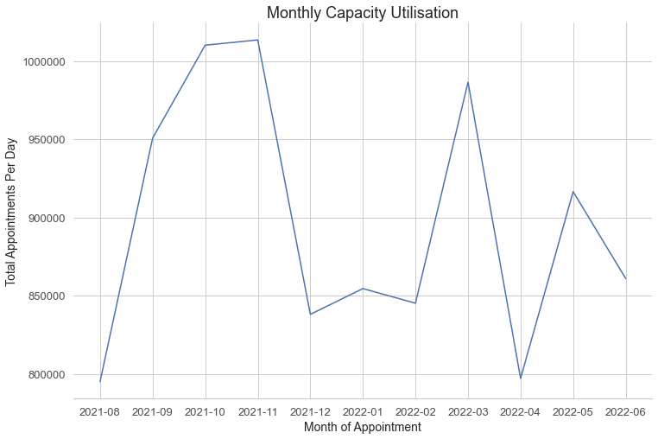
The insights and patterns of our data
Is there adequate capacity in the networks?
Max capacity 1,200,000 daily appointments
Max utilisation 1,013,500 daily appointments

Slide 4
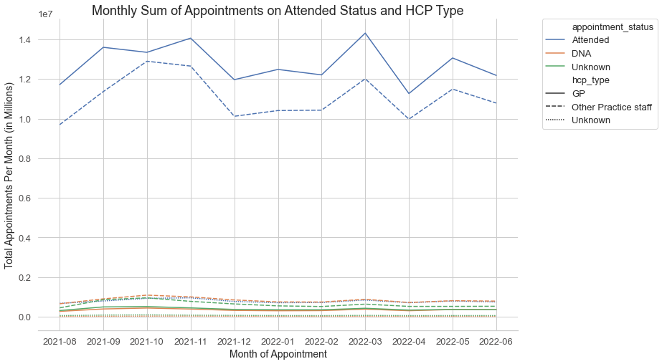
The insights and patterns of our data
Was there adequate staff in the networks?
Majority of appointments attended
Convergence covering GP with other Practice Staff
Usage peak in November and March

Slide 5
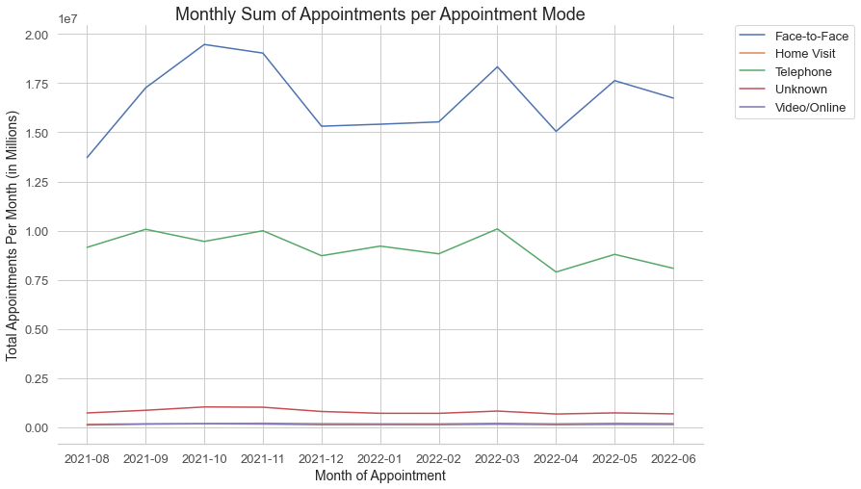
The insights and patterns of our data
How do appointments get attended?
Increased traffic on Face to Face attendance during October November
2nd peak March
Telephone appointment flat curve
10 million diff
20 millions diff

Slide 6
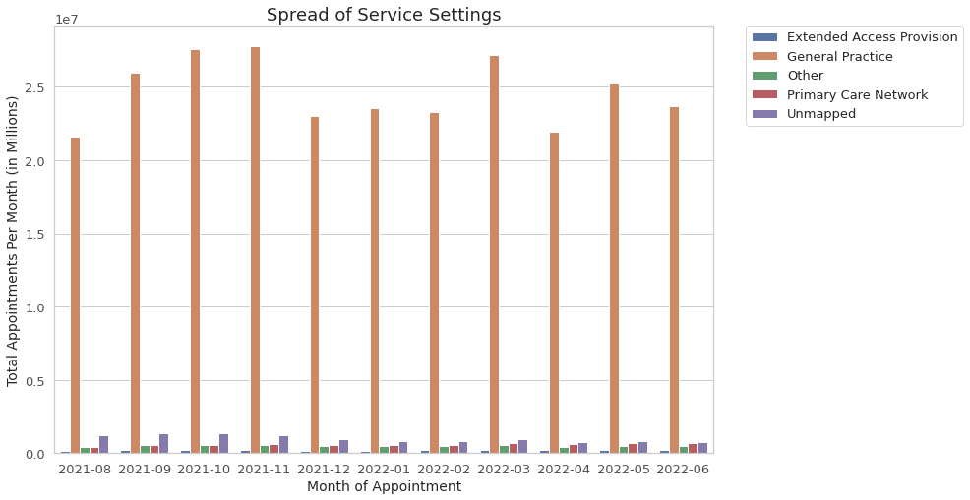
The insights and patterns of our data
Where do people go when they visit?
Concentration of traffic on GP
2nd in ranking unmapped category

Slide 7
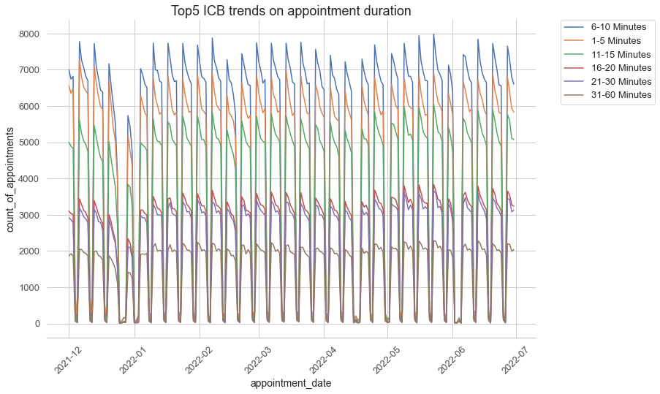
The insights and patterns of our data
Insights on duration?
1st Place 6-10 min
2nd Place 11-15 min
Top 5 ICB (London, Kent, Hampshire)
2 first categories overshadow rest

Slide 8
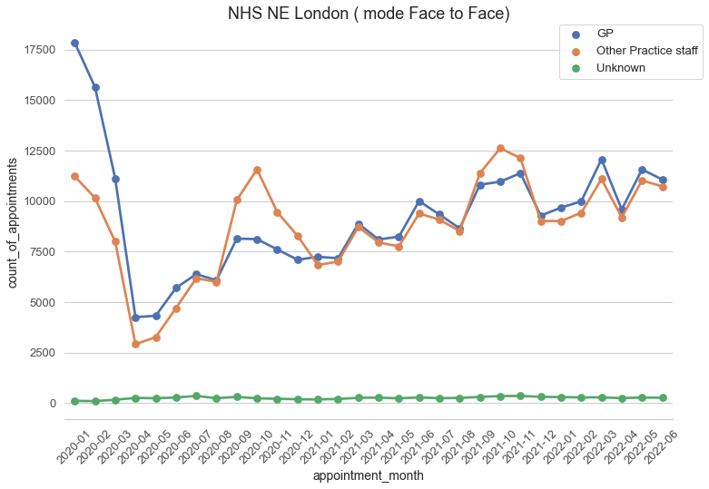
The insights and patterns of our data
NHS of NE London (#1 in appointments)
Starting from March 2020 GP & Other Practice Staff go together
Indicated good data quality and good usage of resources
Diagram shows increased trend in rising of appointments with variable seasonality

Slide 9
Recommendations on NHS
Introduce weekend full time services and shift weekdays workload
Address face to face visits by online methods to avoid ICB congestion
Shift responsibilities of GP areas to other HCP allowing the load to spread to more Doctors
Promote campaign in twitter with hashtag #healthcare
1

Slide 10
Recommendations On Analysis?
Our analysis now
Our future analysis
Data periods not homogeneous
Many categories unmapped or not documented
No information on demand
2
Dataset on all categories within unified time period and daily non aggregated data
All related categories filled under relevant section

Slide 11
How many patients does the NHS see?
3
The NHS now sees and treats more patients than ever before.
1.5 million patients every 24 hours!
It is widely known NHS services come under significant pressure across winter and other holiday periods and although there are regular flows of data across secondary care, the understanding of capacity and utilisation of primary care services is limited.

